Slide 1
Drug Education and Short-term Substance Use
By Ernesto Ye Luo

Slide 2
Background
High Prevalence of Substance Use Among High School Students in the U.S.
66% of 12th graders have tried alcohol (Johnson et al., 2013).
50% of high school students reported ever having used marijuana (The PartnershipTM, 2012).
40% of high school students reported having tried cigarettes (Kann et al., 2014).
Concerns
Substance use among teenagers is associated with increased risk of adult substance dependence, early pregnancy, and crime (Odgers et al., 2008).

Slide 3
Solution?
The U.S. Department of Education invested $85.9 million in developing school-based drug education programs nationwide, with the goal of preventing students from using substances.
Is there a causal relationship between school-based drug education programs and substance use among high school students in the United States?
If so, how effective are drug education programs in preventing high school students from using substances?

Slide 4
Dataset
National Survey on Drug Use and Health, 2012.
Participants were asked to complete full interview surveys for $30 cash in their home.
6 main variables of interest:
Substance use within the past 12 months (yes or no).
Major depression within the past 12 months (yes or no).
Attended school within the past 12 months (yes or no).
Received drug education program within the past 12 months (yes or no).
Race.
Income.

Slide 5
Model Structure
Income Race
Drug Education Substance Use
Major Depression Attended School

Slide 6
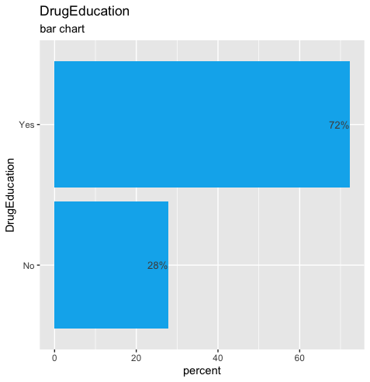
Treatment

Slide 7
Treatment
!!

Slide 8
Treatment
Treatment group consists of “participants who did not receive drug education.”
Control group consists of “participants who received drug education.”

Slide 9
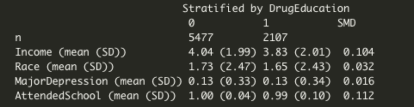
Assessing Balance (Before Matching)

Slide 10
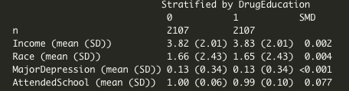
Assessing Balance (After Matching)

Slide 11
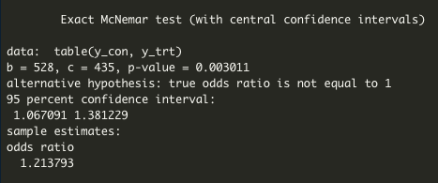
Results
There is a significant causal relationship (p-value < 0.05).
Those who did not received drug education have odds of 1.21 higher on average of using substances compared to those who did received drug education.

Slide 12
Limitations
Assumes that students have not experimented with drugs prior to receiving the drug prevention program.
Assumes that my analysis includes all relevant covariates (does not account for students with disabilities and English learners).
Assumes that the covariates in my analysis are indeed relevant (students of color are empirically associated with higher frequency of skipping school, but there is a lack of theoretical explanation for why they tend to skip school).

Slide 13
Work Cited
Johnson LD, O’Malley PM, Bachman JG, Schulenberg JE, Miech RA. Monitoring the Future national survey results on drug use, 1975-2013: Volume 1, Secondary school students. Ann Arbor, MI: Institute for Social Research, University of Michigan, 2014: 32-36.
The PartnershipTM at Drugfree.Org. 2012 Partnership Attitude Tracking Study: Teens and Parents. 2013.
Kann L, Kinchen S, Shanklin SL, et al. Youth risk behavior surveillance–United States, 2013. MMWR Surveillance Summaries. 2014(63): 17-20.
Odgers, Candice L., et al. "Is it important to prevent early exposure to drugs and alcohol among adolescents?." Psychological science 19.10 (2008): 1037-1044.

Slide 14
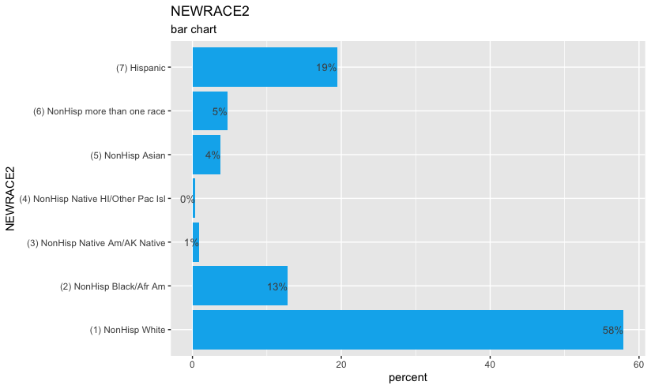
Index
https://www2.ed.gov/datastory/chronicabsenteeism.html#three
https://nces.ed.gov/programs/coe/indicator/cge/racial-ethnic-enrollment

